Slide 1

Phase5 SW Release Plan
Roger Xu, Jiajia Zhou, James Chen
Date: Jan 28, 2021
Desired Outcome
Awareness
Decision
Escalation Help
Think
Point of view
Plan to Implement
Implement

Slide 2
Phase 5 Vehicles Timeline
2021 | 2022 | 2023
1 | 2 | 3 | 4 | 5 | 6 | 7 | 8 | 9 | 10 | 11 | 12 | 1 | 2 | 3 | 4 | 5 | 6 | 7 | 8 | 9 | 10 | 11 | 12 | 1 | 2 | 3 | 4 | 5 | 6 | 7 | 8 | 9 | 10 | 11 | 12
CDX707
UPV1
UPV2
PA
FDJ
DCV
PEC
TT
PP
MP1
FEC
05/28
01/19
02/19
06/30
08/06
05/30
07/26
10/11
02/01
07/11
CDX747
UPV0
UPV1
UPV2
FDJ
DCV
PEC
FEC
TT
PP
MP1
MP2
OK2B
11/23
03/13
06/12
11/06
03/12
06/11
09/24
01/07
07/11
10/26
12/12
10/09
CX788
FDJ
DCV
HB
TT
MP1
MP2
UPV0
UPV1
UPV2
PA
PEC
FEC
PP
OK2B
05/18
03/29
04/26
08/29
11/04
05/24
Lincoln Version
05/10
07/26
10/15
02/10
09/16
10/28
01/17
06/21
Supplier Integration
Ford Version
Supplier Integration
Key New Feature

Slide 3
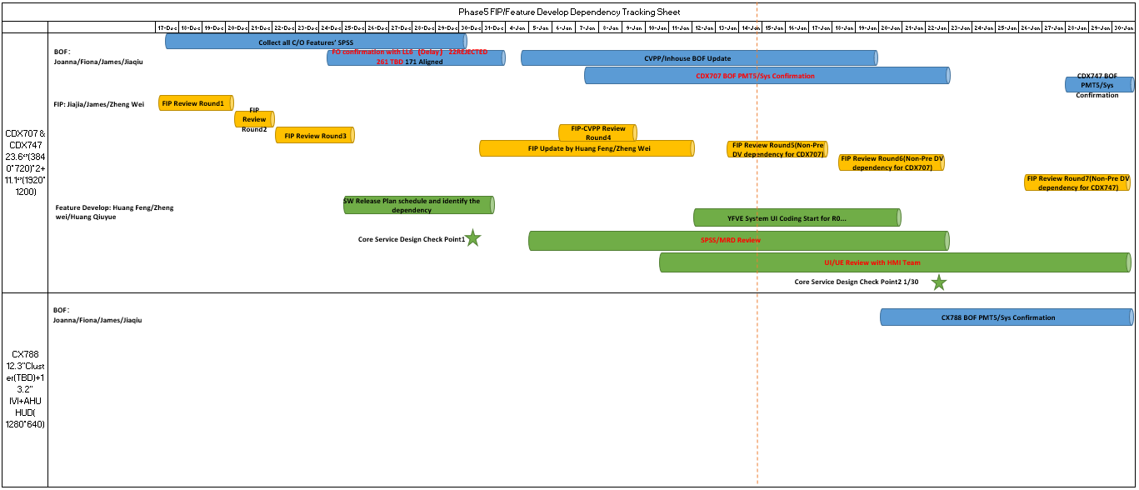
Phase5 FIP Tracking

Slide 4
CDX707 SW Release Plan
2021 | 2022 | 2023
1 | 2 | 3 | 4 | 5 | 6 | 7 | 8 | 9 | 10 | 11 | 12 | 1 | 2 | 3 | 4 | 5 | 6 | 7 | 8 | 9 | 10 | 11 | 12 | 1 | 2 | 3 | 4 | 5 | 6 | 7 | 8 | 9 | 10 | 11 | 12
CDX707 VPP
UPV2
UPV1
PA
FDJ
DCV
PEC
TT
PP
MP1
MP2
FEC
02/19
05/28
06/30
08/06
01/19
05/30
07/26
10/11
02/01
CDC AHU HW
07/11
03/01
07/23-08/20
10/25-12/15
05/15-06/15
Pre-DV
B0 DV1
10/05
DV1
DV2
A0 PCBA
01/07 01/25
A1 PCBA
04/30
A2 Pre-DV
06/30
B1 DV2
04/15
Display(23.6+23.6,11.1 touch)
09/30-10/30
12/05-12/11
23.6 Pre-DV
03/22-06/09
11.1 EMC
23.6 DV
GPDS SW Version for MRD
DCV Beta
07/20
DCV2
01/05
R04
05/30
SW Release for REC
DCV0
10/27
DCV1
11/24
DCV3
02/16
R00
04/18
R05
07/06
R06
09/21
R07 12/06
Spring Festival
National Day
Spring Festival
National Day
Spring Festival
R15
05/18
R16
06/15
R17
07/13
R19
09/07
R20
10/19
R21
11/20
R22 for OKTB
01/15
R1
03/31
R4
06/23
R5
07/10，07/18
R10
12/15
R11
01/12
R12
02/23
R13
03/23
R14
04/20
R18
08/10
R0
03/03
R2
04/28
R3
05/26
R6
08/18
R7
09/15
R8
10/20
R9
11/17
Package 1-HW+Base SW
R15
04/20
R20
09/07
R21
10/19
R22 for OKTB
12/15
R0
02/23
R1
03/03
R2
03/31
R3
04/28
R4
05/26
R5
06/20
R6
07/21
R7
08/18
R8
09/15
R9
10/20
R10
11/17
R11
12/15
R12
01/12
R13
02/23
R14
03/23
R16
05/18
R17
06/15
R18
07/13
R19
08/10
Package 2-Ford core service
R15
04/20
R20
09/07
R21
10/19
R22 for OKTB
12/15
R0
02/23
R1
03/03
R2
03/31
R3
04/28
R4
05/26
R5
06/20
R6
07/21
R7
08/18
R8
09/15
R9
10/20
R10
11/17
R11
12/15
R12
01/12
R13
02/23
R14
03/23
R16
05/18
R17
06/15
R18
07/13
R19
08/10
Package 3-Eco APPs
R15
04/20
R20
09/07
R21
10/19
R22 for OKTB
12/15
Eng version for vendor’s internal release and test.
R0
02/23
R1
03/03
R2
03/31
R3
04/28
R4
05/26
R5
06/20
R6
07/21
R7
08/18
R8
09/15
R9
10/20
R10
11/17
R11
12/15
R12
01/12
R13
02/23
R14
03/23
R16
05/18
R17
06/15
R18
07/13
R19
08/10
Inhouse APPs
Eng version not necessary to release.
R15
04/20
R20
09/07
R21
10/19
R22 for OKTB
12/15
Pro version released for REC, focus and lite test.
R0
02/23
R1
03/03
R2
03/31
R3
04/28
R4
05/26
R5
06/20
R6
07/21
R7
08/18
R8
09/15
R9
10/20
R10
11/17
R11
12/15
R12
01/12
R13
02/23
R14
03/23
R16
05/18
R17
06/15
R18
07/13
R19
08/10
Package 4-HMI
Pro version released for REC, full test.
Group A for DCV Beta
12/15 Delayed to 03/15 UE,04/30 UI
Group C for DCV1
07/30
Group D for DCV2
08/31
Group B for DCV0
06/15

Slide 5
CDX747 SW Release Plan
2021 | 2022 | 2023
1 | 2 | 3 | 4 | 5 | 6 | 7 | 8 | 9 | 10 | 11 | 12 | 1 | 2 | 3 | 4 | 5 | 6 | 7 | 8 | 9 | 10 | 11 | 12 | 1 | 2 | 3 | 4 | 5 | 6 | 7 | 8 | 9 | 10 | 11 | 12
CDX747
UPV0
UPV1
UPV2
FDJ
DCV
PEC
FEC
TT
PP
MP1
MP2
OK2B
01/11
03/13
06/12
10/09
CDC AHU HW
04/06
07/13
10/26
07/11
11/01
11/29
12/12
11/06
07/23-08/20
10/25-12/15
05/15-06/15
Pre-DV
B0 DV1
10/05
DV1
DV2
A0 PCBA
01/07 01/25
A1 PCBA
04/30
A2 Pre-DV
06/30
B1 DV2
04/15
To be updated by Benson Zhang
Display(23.6+23.6,11.1 touch)
09/30-10/30
12/05-12/11
23.6 Pre-DV
03/22-06/09
11.1 EMC
23.6 DV
GPDS SW Version for MRD
DCV Beta
12/15
DCV2
07/05
R04
10/17
R06
02/13
R07 05/06
SW Release for REC
DCV0
04/10
DCV1
05/10
DCV3
08/11
R00
9/15
R05
11/06
Spring Festival
National Day
Spring Festival
National Day
Spring Festival
R28
07/28
R25
04/28
R29
08/28
R30 for OKTB
09/28
R15
05/18
R16
06/15
R17
07/13
R19
09/07
R20
10/19
R21
11/20
R22
01/15
R23
02/28
R24
03/28
R1
03/31
R4
06/23
R5
07/10，07/18
R10
12/15
R11
01/12
R12
02/23
R13
03/23
R14
04/20
R18
08/10
R0
03/03
R2
04/28
R3
05/26
R6
08/18
R7
09/15
R8
10/20
R9
11/17
R27
06/28
R26
05/28
Package 1-HW+Base SW
R15
04/20
R20
09/07
R21
10/19
R22
12/15
R0
02/23
R1
03/03
R2
03/31
R3
04/28
R4
05/26
R5
06/20
R6
07/21
R7
08/18
R8
09/15
R9
10/20
R10
11/17
R11
12/15
R12
01/12
R13
02/23
R14
03/23
R16
05/18
R17
06/15
R18
07/13
R19
08/10
Package 2-Ford core service
R15
04/20
R20
09/07
R21
10/19
R22
12/15
R0
02/23
R1
03/03
R2
03/31
R3
04/28
R4
05/26
R5
06/20
R6
07/21
R7
08/18
R8
09/15
R9
10/20
R10
11/17
R11
12/15
R12
01/12
R13
02/23
R14
03/23
R16
05/18
R17
06/15
R18
07/13
R19
08/10
Package 3-Eco APPs
R15
04/20
R20
09/07
R21
10/19
R22
12/15
Eng version for vendor’s internal release and test.
R0
02/23
R1
03/03
R2
03/31
R3
04/28
R4
05/26
R5
06/20
R6
07/21
R7
08/18
R8
09/15
R9
10/20
R10
11/17
R11
12/15
R12
01/12
R13
02/23
R14
03/23
R16
05/18
R17
06/15
R18
07/13
R19
08/10
Inhouse APPs
Eng version not necessary to release.
R15
04/20
R20
09/07
R21
10/19
R22
12/15
Pro version released for REC, focus and lite test.
R0
02/23
R1
03/03
R2
03/31
R3
04/28
R4
05/26
R5
06/20
R6
07/21
R7
08/18
R8
09/15
R9
10/20
R10
11/17
R11
12/15
R12
01/12
R13
02/23
R14
03/23
R16
05/18
R17
06/15
R18
07/13
R19
08/10
Package 4-HMI
Pro version released for REC, full test.
Group A for DCV Beta
12/15 Delayed to 03/15 UE,04/30 UI
Group C for DCV1
07/30
Group D for DCV2
08/31
Group B for DCV0
06/15

Slide 6
CX707 SW Release Requirement for MRD
R-Event | Software Maturity | Corresponding Milestone | Release Due Date^{*1)} | Build Support
TPB | Fully verified on component level | TPV BB MRD - 1 week | 9/9/2019 | Support TPV BB and TPV T&C MRD
TP3 | Updates Release | TDC - 2weeks | 1/22/2021 | Support TDC
DCV beta | System test on engineering prototype | eBB MRD | 8/6/2021 | Support FDJ
DCV 0 | Fully verified on component level | DCV BB MRD - 4 weeks | 10/27/2021 | Support <DCV BB> MRD and HiL MRD
DCV 1 | Updates Release | T/C MRD - 4 weeks | 11/24/2021 | Support <T/C> MRD
DCV 2 | Updates Release | DCV - 2 weeks | 1/5/2022 | Breadboard update, DCV vehicles update
DCV 3 | Updates Release | DCV+ 4 weeks | 2/16/2022 | Breadboard update, DCV vehicles update
R00 | Feature DV complete. | PEC - 6 weeks | 4/18/2022 | DCV vehicles update for PEC Sign-off
R04 | Feature DV signed off | FEC - 6 weeks | 5/30/2022 | DCV vehicles update for FEC Sign-off
R05 | Fully Validated Release | TT MRD - 4 weeks | 7/6/2022 | Support <TT> MRD
R06 | Fully Validated Release | PP MRD - 4 weeks | 9/21/2022 | Support <PP> MRD
R07 | Fully Validated Release | MP1/J1 MRD - 4 weeks | 12/6/2022 | Support <MP1> MRD

